Slide 1
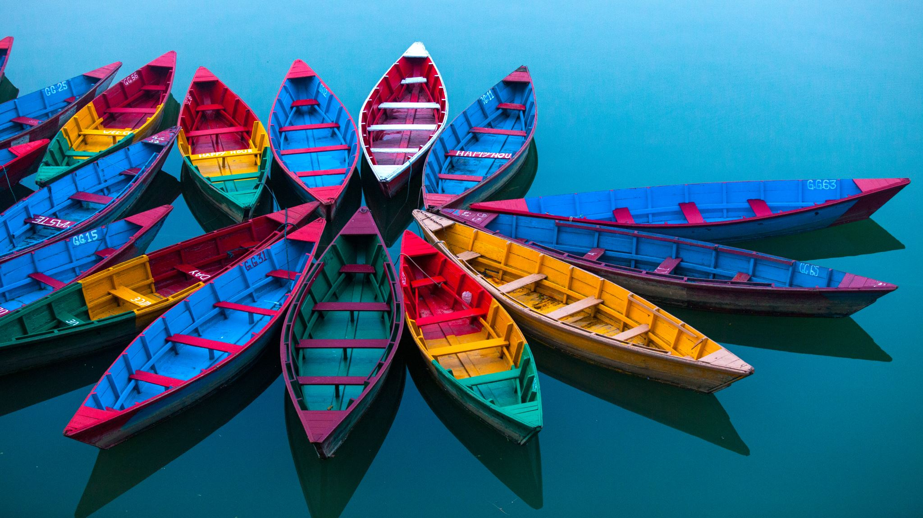
Bangladesh my Beloved Country

Slide 2
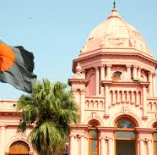
AGENDA
Introduction
Etymology
History
Geography
Governtment & Politics
Economy
Demographics
Culture & Others

Slide 3
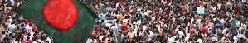
THE POWER OF bangladesh

Slide 4

Intr0duction
Bangladesh,^{[a]} officially the People's Republic of Bangladesh,^{[b]} is a country in South Asia. It is the eighth-most populous country in the world and among the most densely populated with a population exceeding 170 million within an area of 148,460 square kilometres (57,320 sq mi).
Bangladesh,^{[a]} officially the People's Republic of Bangladesh,^{[b]} is a country in South Asia.
It is the eighth-most populous country in the world and among the most densely populated with a population exceeding 170 million within an area of 148,460 square kilometres (57,320 sq mi).

Slide 5
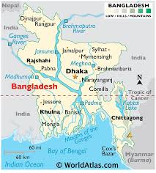

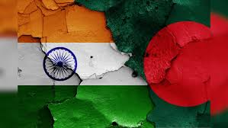
Different side of Bangladesh
Bangladesh shares land borders with India to the north, west, and east, and Myanmar to the southeast. To the south, it has a coastline along the Bay of Bengal. To the north, it is separated from Bhutan and Nepal by the Siliguri Corridor, and from China by the mountainous Indian state of Sikkim.
Dhaka, the capital and largest city, is the nation's political, financial, and cultural centre. Chittagong is the second-largest city and the busiest port of the country. The official language is Bengali. Islam is the official and largest religion and Bengali Muslims form the largest ethnoreligious group in the country.

Slide 6
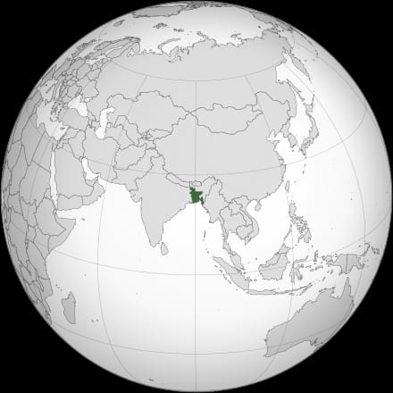
History of Bangladesh
Bangladesh is part of the historic and ethnolinguistic region of Bengal, which was divided during the Partition of British India in 1947 as the eastern exclave of the Dominion of Pakistan. Ancient Bengal was known as Gangaridai and was a stronghold of pre-Islamic kingdoms.
The Muslim conquest after 1204 led to the sultanate and Mughal periods, during which an independent Bengal Sultanate and wealthy Mughal Bengal transformed the region into an important centre of regional affairs, trade, and diplomacy. The Battle of Plassey in 1757 marked the beginning of British rule for next 200 years.

Slide 7
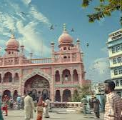
G0vernment & politics
The creation of Eastern Bengal and Assam in 1905 set a precedent for the emergence of Bangladesh.
The All-India Muslim League, which was founded in Dhaka in 1906,^{[16]} fought for a separate Bengali Muslim homeland in the Eastern Bengal, which was proposed in the Lahore Resolution in 1940 by A. K. Fazlul Huq, the first Prime Minister of Bengal.
The present-day territorial boundary was established with the announcement of the Radcliffe Line.

Slide 8
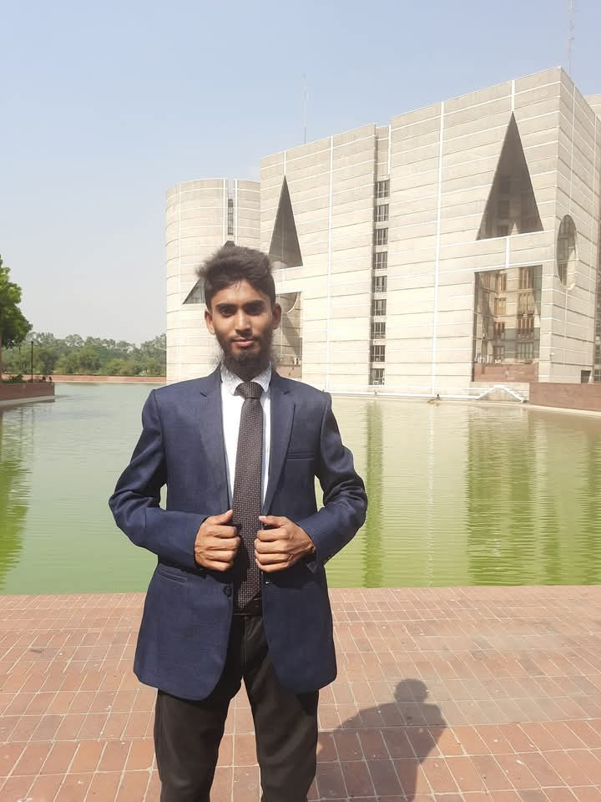
Parliamentary system of Bangladesh
Bangladesh is a unitary parliamentary republic based on the Westminster system. It is a middle power with the second-largest economy in South Asia.
Bangladesh is home to the third-largest Muslim-majority population and the fifth-most spoken native language. It maintains the third-largest military in South Asia and is the largest contributor to UN peacekeeping operations.
It consists of eight divisions, 64 districts, and 495 sub districts, and includes the largest mangrove forest in the world.

Slide 9

THANK YOU
Md. Raju Sheikh
+8801837711584
mraju21.mgt@bu.ac.bd
www.facebook.com/mdrajusheikhmp

